Slide 2
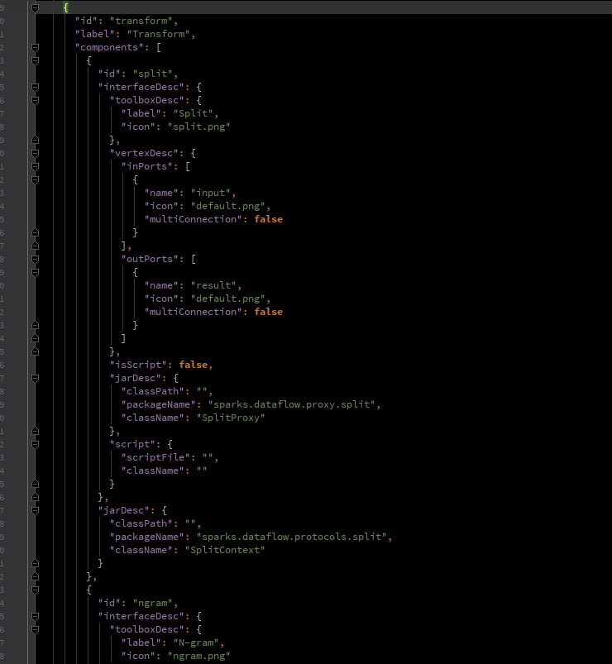
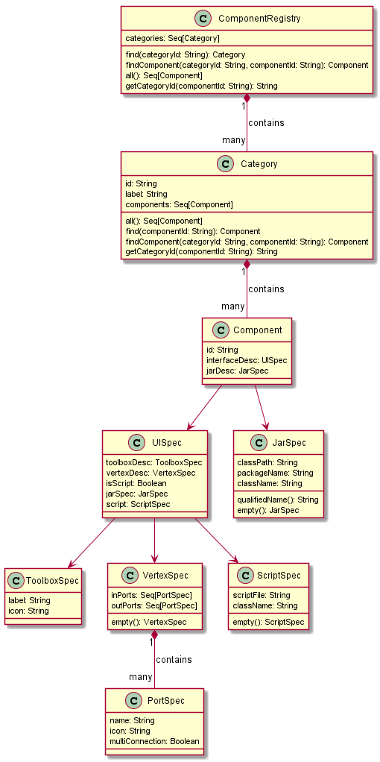

Slide 3
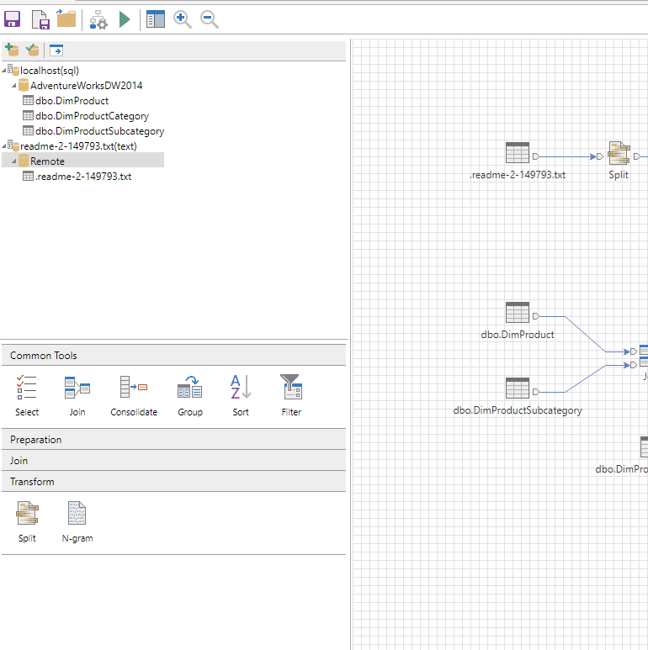


Slide 4
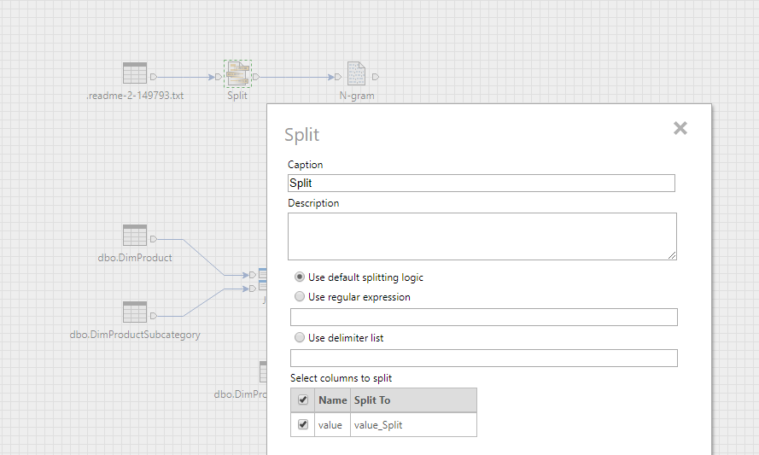
Dataflow
Process
Node
Proxy
Context
Spark
holds state of node
generates
runs
…
edit state of node
Editor

Slide 5
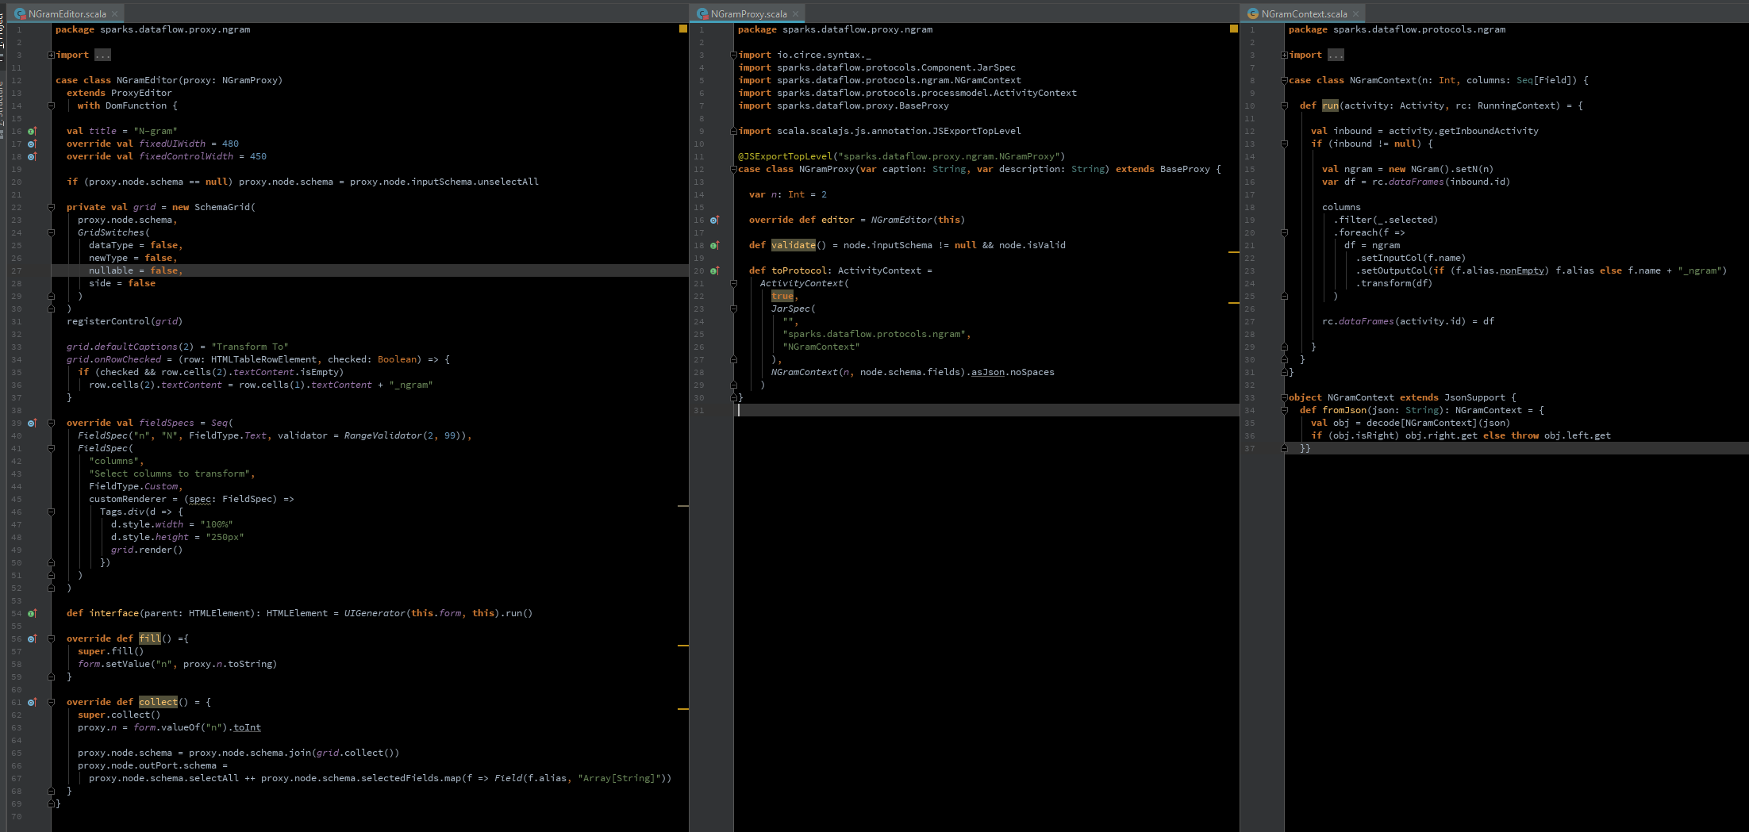
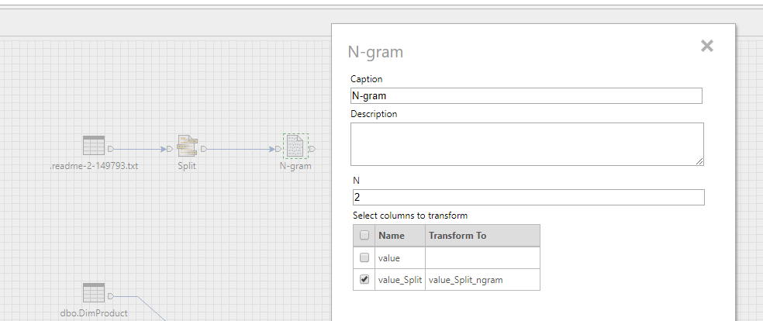
edits
generates

Slide 6
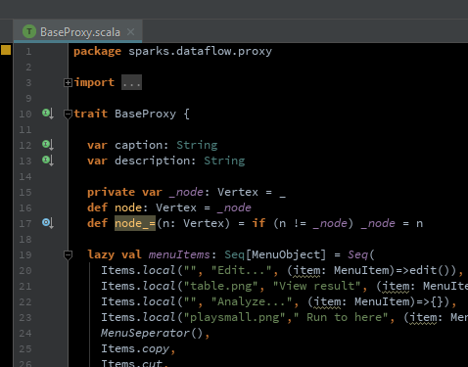
package sparks.dataflow.proxy.ngram import io.circe.syntax._ import sparks.dataflow.protocols.Component.Component import sparks.dataflow.protocols.ngram.NGramContext import sparks.dataflow.protocols.processmodel.ActivityContext import sparks.dataflow.proxy.BaseProxy import scala.scalajs.js.annotation.JSExportTopLevel @JSExportTopLevel("sparks.dataflow.proxy.ngram.NGramProxy") case class NGramProxy(spec: Component) extends BaseProxy { var n: Int = 2 override def editor = NGramEditor(this) def validate() = node.inputSchema != null && node.isValid def toProtocol: ActivityContext = ActivityContext( spec.jarDesc, NGramContext(n, node.schema.fields).asJson.noSpaces ) }
exports the editor itself in the JavaScript global scope.

Slide 7
trait ProxyEditor extends Entity with DomFunction { val proxy: BaseProxy val autoGenerateUI = false var caption: HTMLInputElement = _ var description: HTMLTextAreaElement = _ def userDefinedUI: HTMLElement = { import Tags._ table( t => { t.style.tableLayout = "fixed" t.style.width = fixedUIWidth + "px" }, tr(td(label("Caption"))), tr(td { caption = input caption.style.width = if (fixedControlWidth > 0) s"${fixedControlWidth}px" else "85%" caption }), tr(td(label("Description"))), tr(td { description = textArea description.style.width = if (fixedControlWidth > 0) s"${fixedControlWidth}px" else "85%" description.style.height = "50px" description }), //spacerRow(1), tr( td { cell => { cell.style.height = "250px" cell.style.verticalAlign = "top" interface(cell) }} ) ) } def interface(parent: HTMLElement): HTMLElement def fill(): Unit = { caption.value = proxy.caption description.value = proxy.description } def collect(): Unit = { proxy.caption = caption.value proxy.description = description.value } }

Slide 8
case class NGramEditor(proxy: NGramProxy) extends ProxyEditor { val title = "N-gram" override val fixedUIWidth = 480 if (proxy.node.schema == null) proxy.node.schema = proxy.node.inputSchema.unselectAll private val grid = getSchemaGrid( proxy.node.schema, GridSwitches( dataType = false, newType = false, nullable = false, side = false ) ) grid.defaultCaptions(2) = "Transform To" grid.onRowChecked = (row: HTMLTableRowElement, checked: Boolean) => { if (checked && row.cells(2).textContent.isEmpty) row.cells(2).textContent = row.cells(1).textContent + "_ngram" } override val fieldSpecs = Seq( FieldSpec("n", "N", FieldType.Text, validator = RangeValidator(2, 99)), SchemaGridFieldSpec( "columns", "Select columns to transform", grid, validationRule = () => grid.checkedCount > 0 ) ) override def fill() ={ super.fill() form.setValue("n", proxy.n.toString) } override def collect() = { super.collect() proxy.n = form.valueOf("n").toInt proxy.node.schema = proxy.node.schema.join(grid.collect()) proxy.node.outPort.schema = proxy.node.schema.clearAlias.selectAll ++ proxy.node.schema.selectedFields.map(f => Field(f.alias, "Array[String]")) } }
ProxyEditor
extends
NGramEditor
edits
NGramProxy

Slide 9
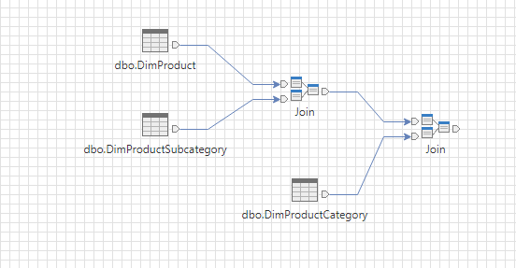
Vertex
extends
inPorts
node
outPorts
VertexPort
extends
Graph
extends
link
extends
Edge
Diagram

Slide 10
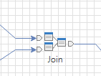
GraphModel
trait Vertex { val id: Int val graph: Graph var schema: Schema def inPort: VertexPort = if (inPorts.isEmpty) null else inPorts.head def outPort: VertexPort = if (outPorts.isEmpty) null else outPorts.head def inPorts: ListBuffer[VertexPort] def outPorts: ListBuffer[VertexPort] implicit class PortListExtension(list: ListBuffer[VertexPort]) { // Special accessor for inputSchema def fromSchema(index: Int): Schema = { if (index < list.length) { val port = list(index) if (port.link == null || port.link.from == null) null else port.link.from.schema } else throw new Exception("Port index out of range.") } // Special accessor for selfSchema def schema(index: Int): Schema = { if (index < list.length) { val port = list(index) if (port == null) null else port.schema } else throw new Exception("Port index out of range.") } } def inputSchema: Schema = inPorts.fromSchema(0) def inputSchemas(index: Int): Schema = inPorts.fromSchema(index) def outputSchema: Schema = outPorts.schema(0) def outputSchemas(index: Int): Schema = outPorts.schema(index) def isValid = schema != null && outputSchema != null def validate(): Boolean }
trait Graph { val id: UUID def nodes: ListBuffer[Vertex] }
trait Edge { var from: VertexPort var to: VertexPort }
trait VertexPort { val id: Int var schema: Schema // output schema def link: Edge // shortcut to the first link def links: ListBuffer[Edge] }

Slide 11
trait Vertex {
…
var schema: Schema
…
def inPort: VertexPort = if (inPorts.isEmpty) null else inPorts.head
def outPort: VertexPort = if (outPorts.isEmpty) null else outPorts.head
…
…
}
case class NGramEditor(proxy: NGramProxy) extends ProxyEditor with DomFunction {
.
.
.
override def collect() = { super.collect() proxy.n = form.valueOf("n").toInt proxy.node.schema = proxy.node.schema.join(grid.collect())
proxy.node.outPort.schema = proxy.node.schema.selectAll ++ proxy.node.schema.selectedFields.map(f => Field(f.alias, "Array[String]"))
} }
trait VertexPort { val id: Int var schema: Schema // output schema
…
…
}

Slide 12
case class NGramContext ( n: Int , columns: Seq[Field] ) { def run(activity: Activity, rc: RunningContext) = { val inbound = activity.getInboundActivity if (inbound != null) { val ngram = new NGram().setN(n) var df = rc.dataFrames(inbound.id) columns .filter(_.selected) .foreach(f => df = ngram .setInputCol(f.name) .setOutputCol(if (f.alias.nonEmpty) f.alias else f.name + "_ngram") .transform(df) ) rc.dataFrames(activity.id) = df } } } object NGramContext extends JsonSupport { def fromJson(json: String): NGramContext = { val obj = decode[NGramContext](json) if (obj.isRight) obj.right.get else throw obj.left.get }}
@JSExportTopLevel("sparks.dataflow.proxy.ngram.NGramProxy") case class NGramProxy(var caption: String, var description: String) extends BaseProxy { var n: Int = 2 override def editor = NGramEditor(this) def validate() = node.inputSchema != null && node.isValid def toProtocol: ActivityContext = ActivityContext( true, JarSpec( "", "sparks.dataflow.protocols.ngram", "NGramContext" ),
NGramContext( n , node.schema.fields ).asJson.noSpaces
) }

Slide 13
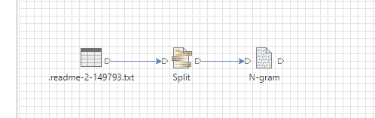
case class NGramContext(n: Int, columns: Seq[Field]) { def run(activity: Activity, rc: RunningContext) = { val inbound = activity.getInboundActivity if (inbound != null) { val ngram = new NGram().setN(n)
var df = rc.dataFrames(inbound.id) columns .filter(_.selected) .foreach(f => df = ngram
.setInputCol(f.name)
.setOutputCol(if (f.alias.nonEmpty) f.alias else f.name + "_ngram")
.transform(df)
) rc.dataFrames(activity.id) = df } } }

Slide 14
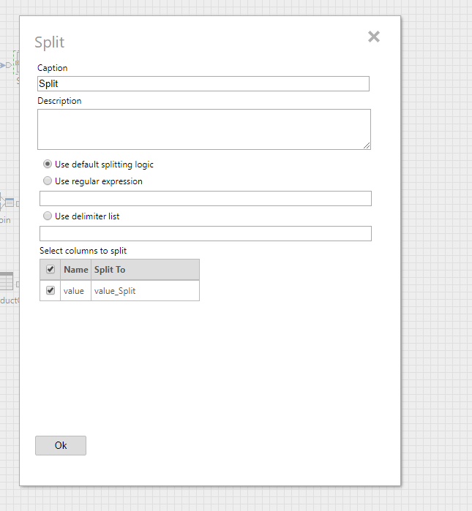
override val fieldSpecs = Seq(
FieldSpec("sptype", "Use default splitting logic", FieldType.RadioButton, userData = "default"), FieldSpec("sptype", "Use regular expression", FieldType.RadioButton, userData = "regex"), FieldSpec("regex", "", FieldType.Text, validator = CustomValidator(v => if (form.valueOf("sptype") == "regex") v.nonEmpty else true)), FieldSpec("sptype", "Use delimiter list", FieldType.RadioButton, userData = "delimiters"), FieldSpec("delimiters", "", FieldType.Text, validator = CustomValidator(v => if (form.valueOf("sptype") == "delimiters") v.nonEmpty else true)),
FieldSpec( "columns", "Select columns to split", FieldType.Custom, customRenderer = (spec: FieldSpec) => Tags.div(d => { d.style.width = "100%" d.style.height = "200px" grid.render() }) ) )

Slide 15
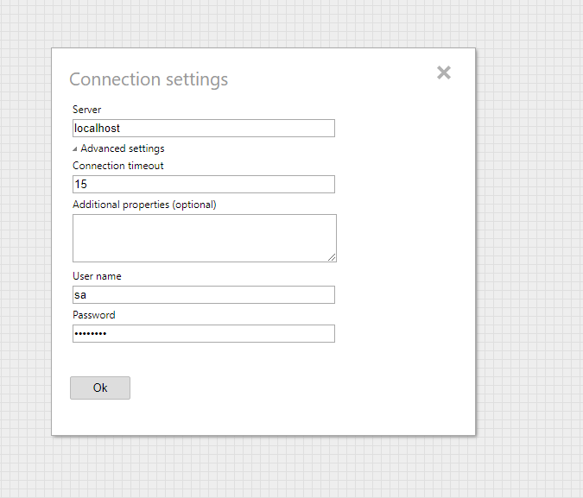
override val fieldSpecs = Seq(
FieldSpec("server", "Server", FieldType.Text, validator = RequiredValidator()),
FieldSpec("adv", "Advanced settings", FieldType.Collapsable, childSpecs = Seq( FieldSpec("timeout", "Connection timeout", FieldType.Text, validator = RangeValidator(0, 9999)), FieldSpec("additionalProps", "Additional properties (optional)", FieldType.TextArea, height = 50) ) ),
FieldSpec("userName", "User name", FieldType.Text, validator = RequiredValidator()),
FieldSpec("password", "Password", FieldType.Password) )
nested

Slide 16
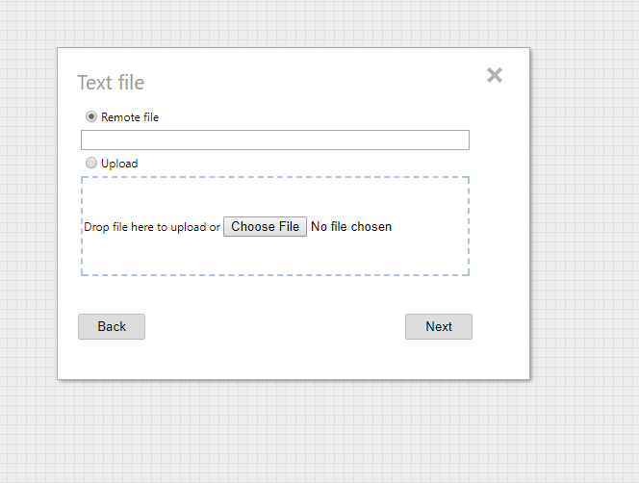
override val fieldSpecs = Seq( FieldSpec("loc", "Remote file", FieldType.RadioButton, userData = "remote"), FieldSpec( "url", "", FieldType.Text, validator = CustomValidator(v => if (form.valueOf("loc") == "remote") v.nonEmpty else true) ), FieldSpec("loc", "Upload", FieldType.RadioButton, userData = "local"), FieldSpec("upload", "", FieldType.UploadArea) )

Slide 17
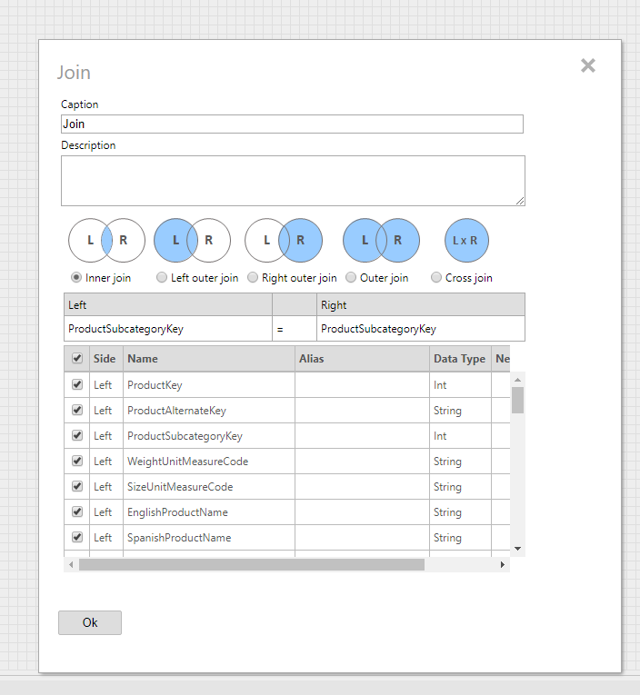
case class JoinEditor(proxy: JoinProxy) extends ProxyEditor with DomFunction with AjaxClient {
… private val mapper: KeyMapper = KeyMapper(proxy) … private val grid = new SchemaGrid(proxy.node.schema, GridSwitches()) registerControl(grid)
… def interface(parent: HTMLElement): HTMLElement = { if (proxy.keys == null) proxy.initKeys() import Tags._ div(d => { table( tr( td( table( tr( td(img("/images/icons/dataflow/join_inner.png")), td(img("/images/icons/dataflow/join_left_outer.png")), td(img("/images/icons/dataflow/join_right_outer.png")), td(img("/images/icons/dataflow/join_full_outer.png")), td(img("/images/icons/dataflow/join_cross.png")) ), tr( td(radioButton("Inner join", "inner", "join")), td(radioButton("Left outer join", "leftouter", "join")), td(radioButton("Right outer join", "rightouter", "join")), td(radioButton("Outer join", "outer", "join")), td(radioButton("Cross join", "cross", "join")) ) ) ) ), tr(td(mapper.render())), tr(td(c => { c.style.height = "250px" grid.render() })) ) }) } }

